Slide 1
Building Event Driven Cloud Architecutres
Learn software techniques to improve scalability in cloud systems

Slide 2
Chris Berthold : That guy that talks too much
Over 15 years of development experience developing software and DevOps/network administration
10 years of business development in a manufacturing setting
6 years of development as software consultant
Private pilot
2 years with the awesome Product Development Team for Baxter Technology
Enjoys software architecture, simplifying software design and practical performance in applications
http://github.com/cberthold/presentations

Slide 3
Talk about it
Monolithic applications
Scaling
Events made simple
Events in the cloud
Demo Event-Driven Todo

Slide 4
Enter the Big Ball of Mud
Notes:
Lots of moving pieces with many interdependencies

Slide 5
Traditional N-Tier Architecture
Notes:
50,000 foot view – Many ORM Mapping classes and domain logic to make state changes

Slide 6
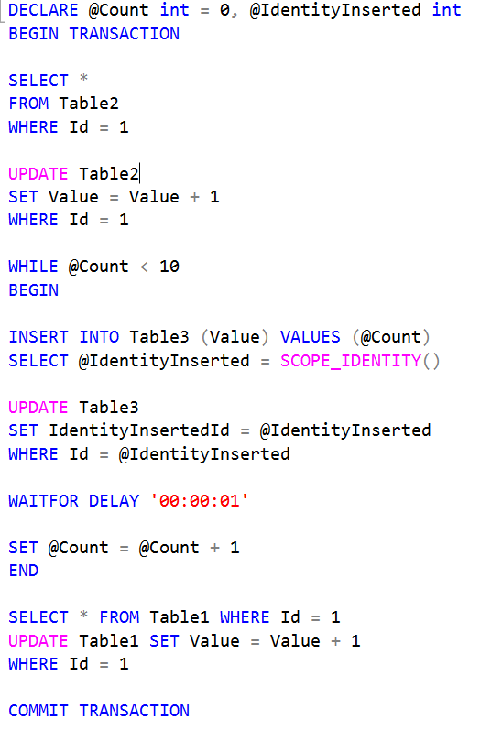
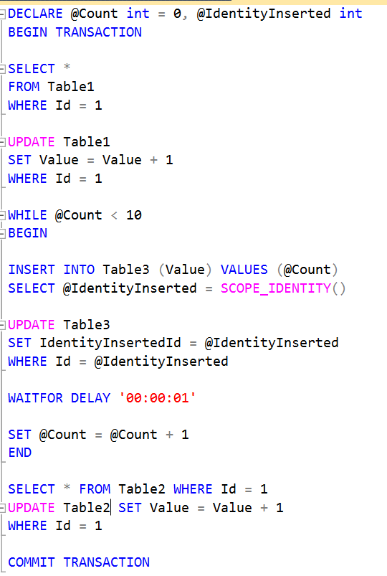
Notes:
Only takes a small error to cause scale to be a problem even for two users

Slide 7
Cloud: Vertical Scaling
Adding resources to a single node
More processors (quantity of processes) or faster processors (reduce latency)
More hard drives (more storage and I/O), faster drives (reduce latency)
More memory (more storage) or faster memory (reduce latency)
Faster/More Network Cards (more network capacity and/or reduce latency)
Database Software Versions (SQL Web, Standard, Enterprise)
Side effects
Costs go up exponentially towards upper limits of scale
Complexity remains relatively constant
Once limits are hit no further growth can be attained

Slide 8
Cloud: Horizontal Scaling
Horizontal Scaling
Distribute the load using load balancers
Adding more nodes to the system
Shard – break the load into pieces
Side effects
Cost of many pieces of commodity hardware can actually cost less and allow more scale over faster, more expensive hardware
Costs can be maintained based on load – scaling in and out
Overall costs will be rather constant as scale increases
Complexity goes up with each section of system that is scaled
Development time tends to go up

Slide 9
Event Driven Architecture
Event-driven architecture (EDA), also known as Message-driven architecture, is a software architecture pattern promoting the production, detection, consumption of, and reaction to events.
https://en.wikipedia.org/wiki/Event-driven_architecture
How do we build a pattern out of an architecture?
Patterns suggest repeatable process and no two event driven architectures are created equal
Some systems ingest invents at a high rate and some expel events at a high rate. Some generate very few events and are mostly read.

Slide 10
What is an Event?
e·vent əˈvent/ - noun
a thing that happens, especially one of importance.
Immutable – it doesn’t change.
If it does, it is a new event
If it has a system address - it’s a message
Think mailbox
Forces you to think of a system in terms of behavior instead of structural domains
Events are temporal – they happened – 0ms is still a time in the past
Eventually consistent
Request / Response – Request is a command and Response is what happened, an Event!
Lets demonstrate!

Slide 11
Event Stream
Sequence # | Transaction Type | Amount
1 | Account Balance Started | $100

Slide 12
Event Stream
Sequence # | Transaction Type | Amount
1 | Account Balance Started | $100
2 | Deposit | $50

Slide 13
Event Stream
Sequence # | Transaction Type | Amount
1 | Account Balance Started | $100
2 | Deposit | $50
3 | Debit | $40

Slide 14
Event Stream
Sequence # | Transaction Type | Amount
1 | Account Balance Started | $100
2 | Deposit | $50
3 | Debit | $50
4 | Debit | $300

Slide 15
Event Stream
Sequence # | Transaction Type | Amount
1 | Account Balance Started | $100
2 | Deposit | $50
3 | Debit | $50
4 | Debit | $300
Did you total to: $0???

Slide 16
Event Stream
Sequence # | Transaction Type | Amount
1 | Account Balance Started | $100
2 | Deposit | $50
3 | Debit | $50
4 | Debit | $300
4 | Debit | $100
Events must remain immutable!

Slide 17
Typical Todo List Application
AngularJS app
Change Requests
Changed View Model
Web API
Server

Slide 18
Todo List Application
AngularJS app
AngularJS app
Change Requests
Changed View Model
Acknowledgements
Changed View Model
SignalR
Server
Web API
Server
SignalR
Server
Changed View Model
Data Changed Events
Project into
View Model
RabbitMQ
Server
Changed View Model

Slide 19
Todo List Application
Command received by API
Command Dispatcher executes validation and sends to service bus for execution
Command Handler is executed for command
Domain logic is performed
Events returned
Events or Domain Saved to write database
Events sent to dispatcher/service bus
Denormalizers create read model
Multiple DTO views created
Saved Models to Read DB
Notify UI of changes
UI Reads changes from Read DB
User Interface
12
1
11
Query / Normal DAL
Command
2
Read
DB
Command Dispatcher/
Service Bus
8
Denormalizers
9
10
3
7
Command Handler
DTOs
DTOs
5
6
Write
DB
DTOs
4
Domain Object
Aggregate Root

Slide 20
Command Dispatcher / Command Processor
Allows decoupling of how the command message is handled from the requestor
Registers command handlers for processing of command
Dispatches command requests
Allows for other orthogonal processes such as logging, transactions, command sourcing (save the command message)
https://iancooper.github.io/Paramore/CommandsCommandDispatcherandProcessor.html

Slide 21
Domain Driven Design (DDD)
Domain Driven Design is actually not a software pattern
Focuses on modeling the business
Processes that include discussions with the business, called Event Storming
Described in terms of nouns (objects), verbs (functions/actions) and events (results)
Contains a Ubiquitous Language that is common amongst developers and the business Domain Expert(s)
Precludes any infrastructure concerns and is highly testable
Works well with Business/Behavior Driven Development (BDD) where we specify the nouns, verbs, and results before writing the software
DDD-Lite or Domain Events / Emit Apply Pattern
Aggregate Root – Produces events from logic which changes domain in a 2-phase commit
Writes to database either as Domain Objects (ORM) or Events (Event Sourcing)
Its NOT CRUD, but can be made to model CRUD apps (CRUD = Anemic domain model)

Slide 22
Event Sourcing
Write-Once Read-Many append-only database of events
Extremely efficient reads and writes
Full audit trail
State is a first level derivation of events
Avoids the impedance mismatch of domain to database (ORM Hell)
Makes it easy to change out the backing store
https://msdn.microsoft.com/en-us/library/dn589792.aspx

Slide 23
Projections / Denormalizer / Materialized View
Builds the current state from a stream of events
Allows building our read model in multiple forms for performance
Think NoSQL for detail screens and SQL for Ad-hoc list queries
Its OK to duplicate data. Index in SQL are duplicates. These are indexed views of data.
Denormalizers can be distributed to remote nodes for global reads using Rabbit MQ
https://abdullin.com/post/event-sourcing-projections/
http://blog.arkency.com/2015/03/why-use-event-sourcing/

Slide 24
Todo List Application – Big bad message Anti-Pattern
AngularJS app
AngularJS app
Change Requests
Changed View Model
Acknowledgements
Changed View Model
SignalR
Server
This view model could be huge
Web API
Server
SignalR
Server
Changed View Model
Data Changed Events
Project into
View Model
RabbitMQ
Server
Changed View Model

Slide 25
Frameworks / Projects / Examples
https://github.com/haf/Documently
https://github.com/gregoryyoung/m-r
https://github.com/NEventStore
https://github.com/d60/Cirqus - if you use a framework look here

Slide 26
Related Topics
Micro services
Scaling across smaller domains
Functional Programming
Left Fold Over Previous History
Flux / React
Event driven / event sourced system
Actor / Model - Akka.NET
Event driven processing / event sourcing

Slide 27
Resources
Making Sense of Stream Processing http://www.confluent.io/blog/making-sense-of-stream-processing/
Event Sourcing / DDD – Greg Young (one of the founders of CQRS) https://www.youtube.com/watch?v=LDW0QWie21s
Architectural Simplicity Through Events – Russ Miles https://www.youtube.com/watch?v=YWHaEJjL8qA
Eventually Consistent Distributed Systems Stephan Kutko https://www.youtube.com/watch?v=X_VHWQa1k0k
The future of .Net – Actor Model systems https://petabridge.com/blog/the-new-dot-net-stack/#morelink https://azure.microsoft.com/en-us/services/service-fabric/

